Slide 1



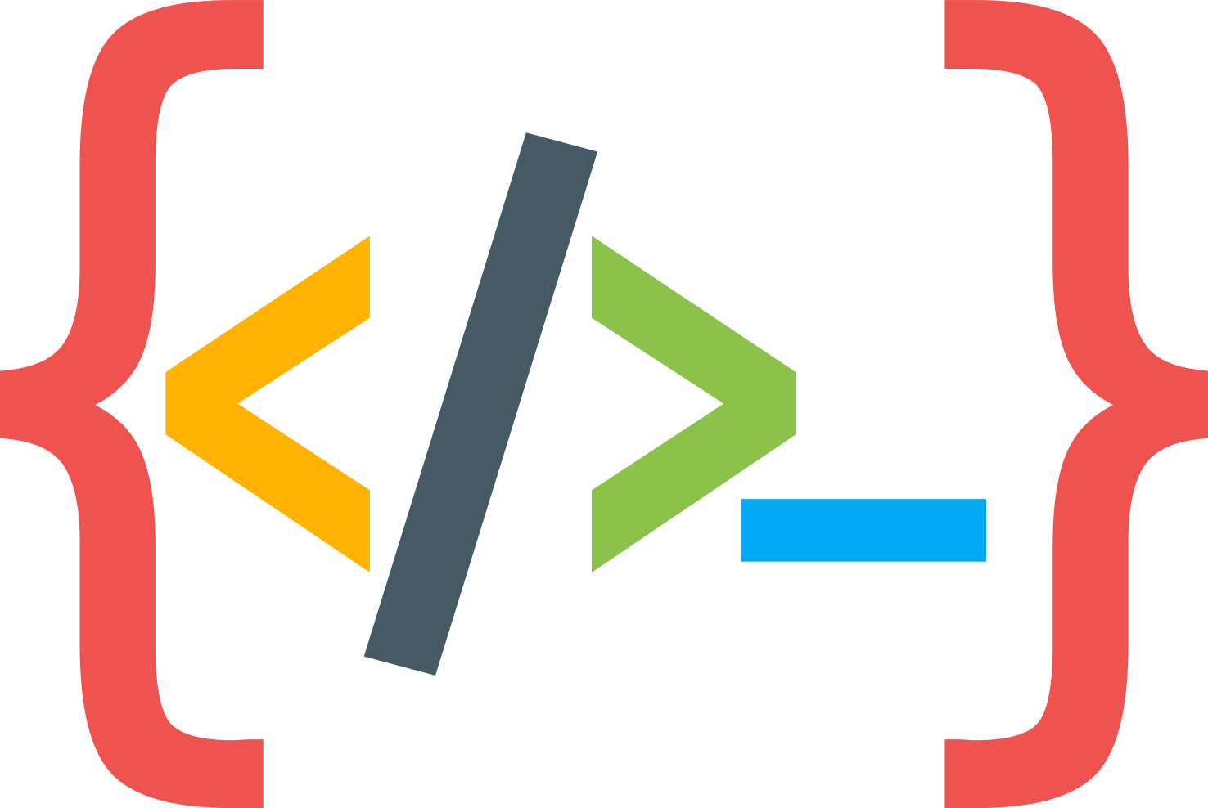
Python Programming Summer Camp
Class # 3
Its all about Loops
(Not Fruit Loops)
By Asim Munawar

Slide 2
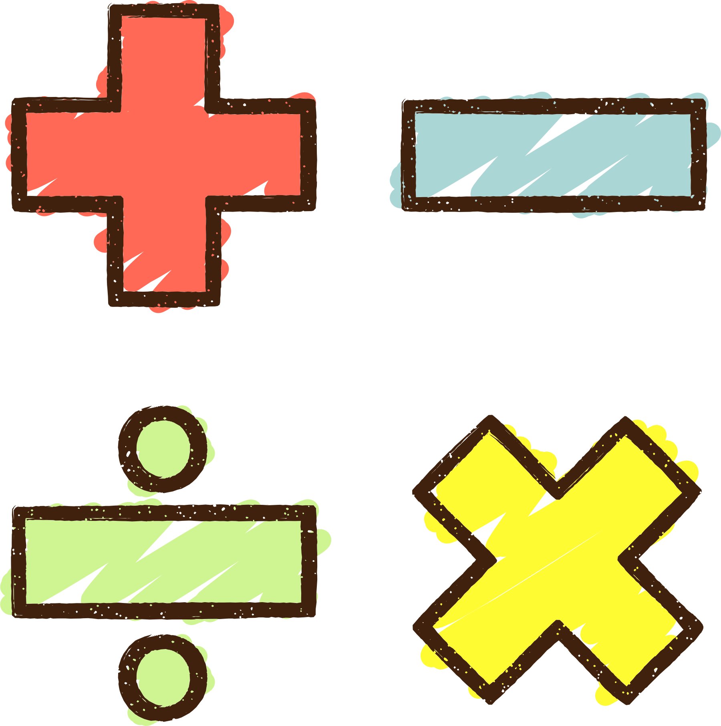

Revise: Variables and If/Else
Variable
and - or
finish_course = "yes"
submit_homework = "yes"
if finish_course == "yes" and submit_homework == "yes":
print("🎉 You will get a certificate and a gift!")
else:
print("⚠️ You will not get the certificate.")
if/else

Slide 3
Revise: Variables and If/Else
raining = "yes"
snowing = "no"
if raining == "yes" or snowing == "yes":
print("Stay indoor.")
else:
print("Go out.")

Slide 4
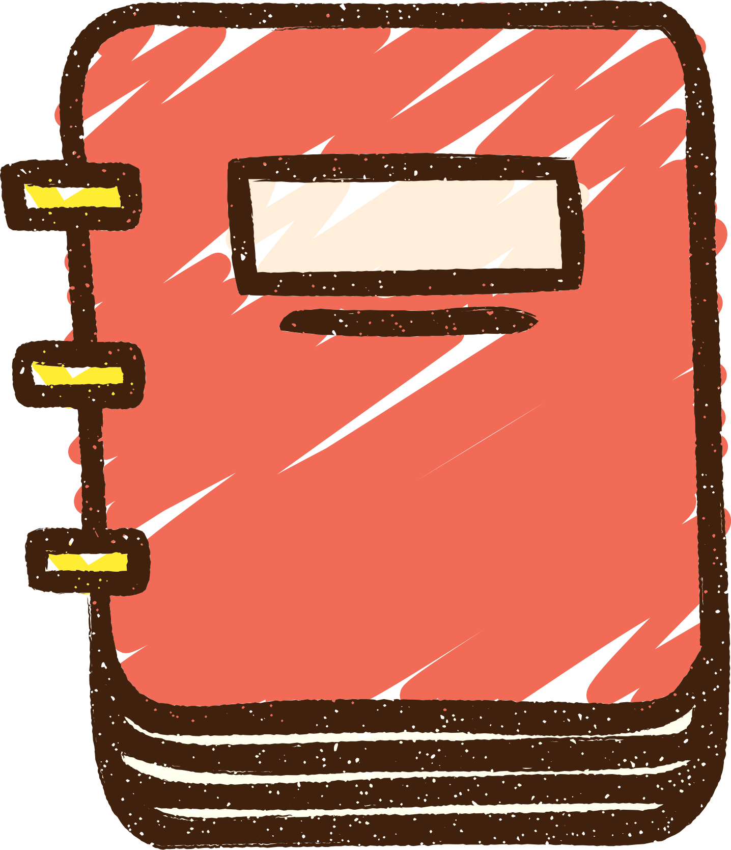
Course Plan
Lesson 1: Printing Fun – Say Hello to Python
Lesson 2: Variables – Remembering Things in Code
Lesson 2: If/Else – Making Decisions
Lesson 3: Loops – Doing Things Again and Again / Inputs
Lesson 4: Build a Mini Game – Guessing or Quiz
Lesson 5: Lists – Collecting Many Things
Lesson 6: Functions – Teach the Computer a New Trick
Lesson 7: Files – Saving and Reading Data
Lesson 8: Simple App with Gradio – Make Your Own Tool
Lesson 9: Final Project – Build and Present Your App

Slide 5
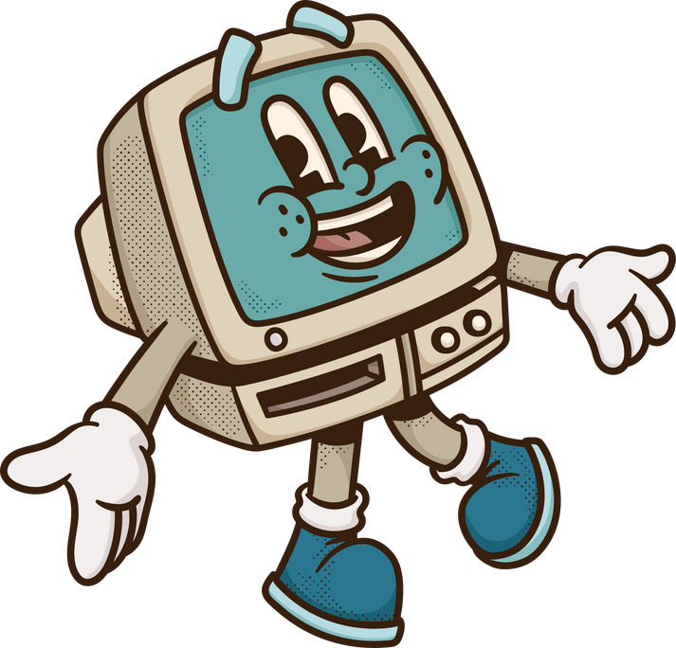
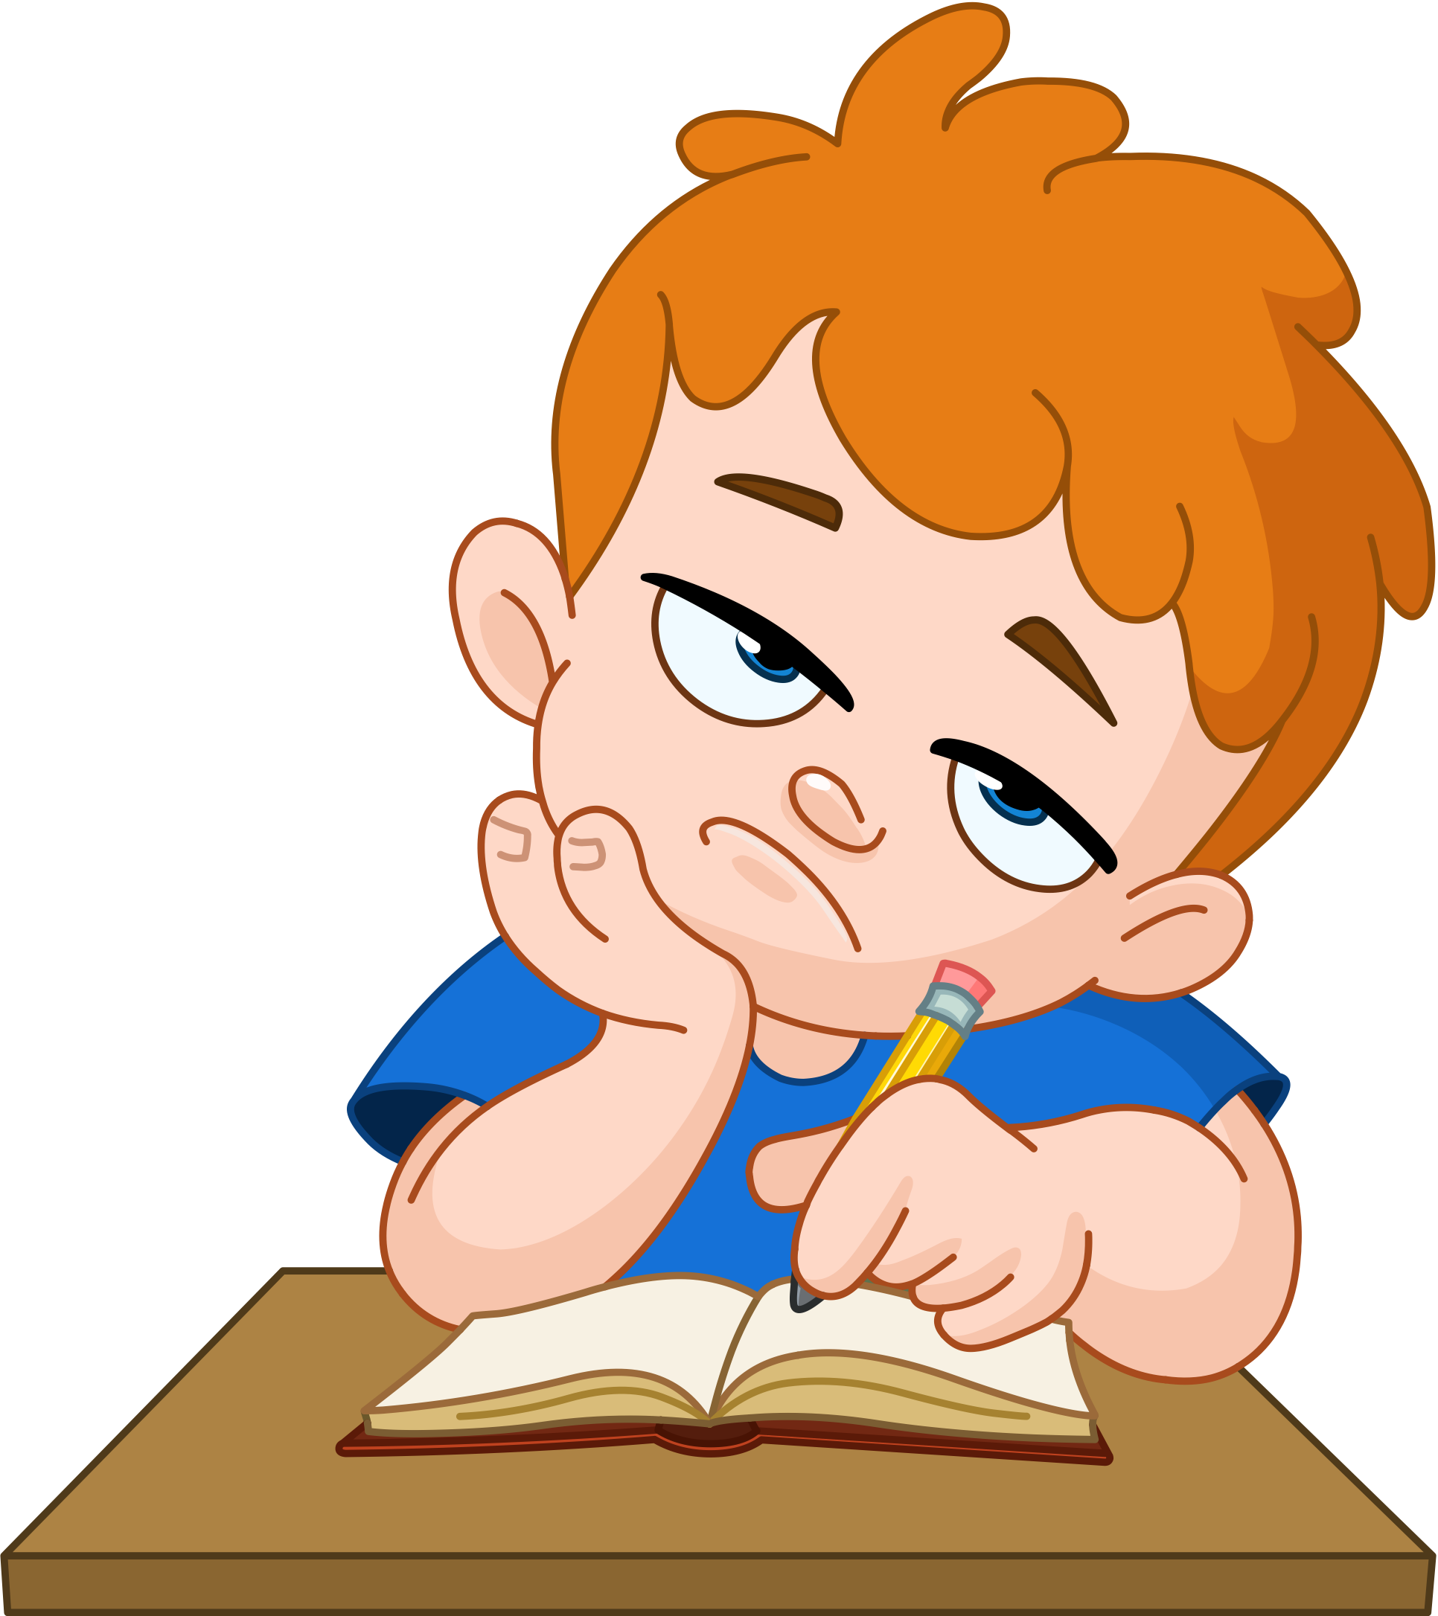

Repeating is Boring
Task: Write “I like programming” 100 times
So boring
So tiring
I love repeating Tasks

Slide 6
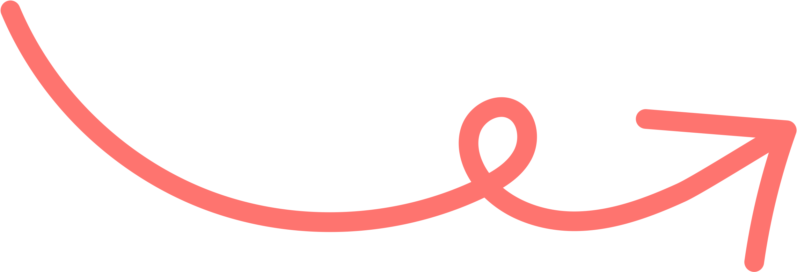
Repeat Print
for i in range(100):
print(i)
for i in range(100):
print(i,"\t I like programming.")

Slide 7
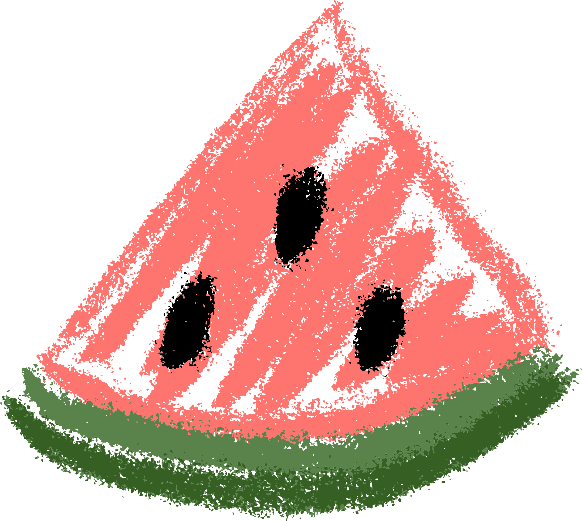
Get Input from User
name = input("What is your name? ")
age = input("How old are you? ")
print("Hello", name + "!")
print("You are", age, "years old.")

Slide 8
Types of Variables
int Integer (whole number) age = 10
float Decimal number price = 3.14
str String (text) name = "Ali"
bool Boolean (True/False) is_ready = True

Slide 9
Task # 1: Draw a Triangle
rows = int(input("How many rows? "))
for i in range(rows):
print("X" * (i+1))
Why not i ?

Slide 10

Task # 2: Find Error(s)
1score = 0
for i in range(3):
answer = input("What is 2 + 2? ")
if answer == 4:
print("Correct!")
score = score + 1
else:
print("Wrong!")
print("Your score is:", score)

Slide 11
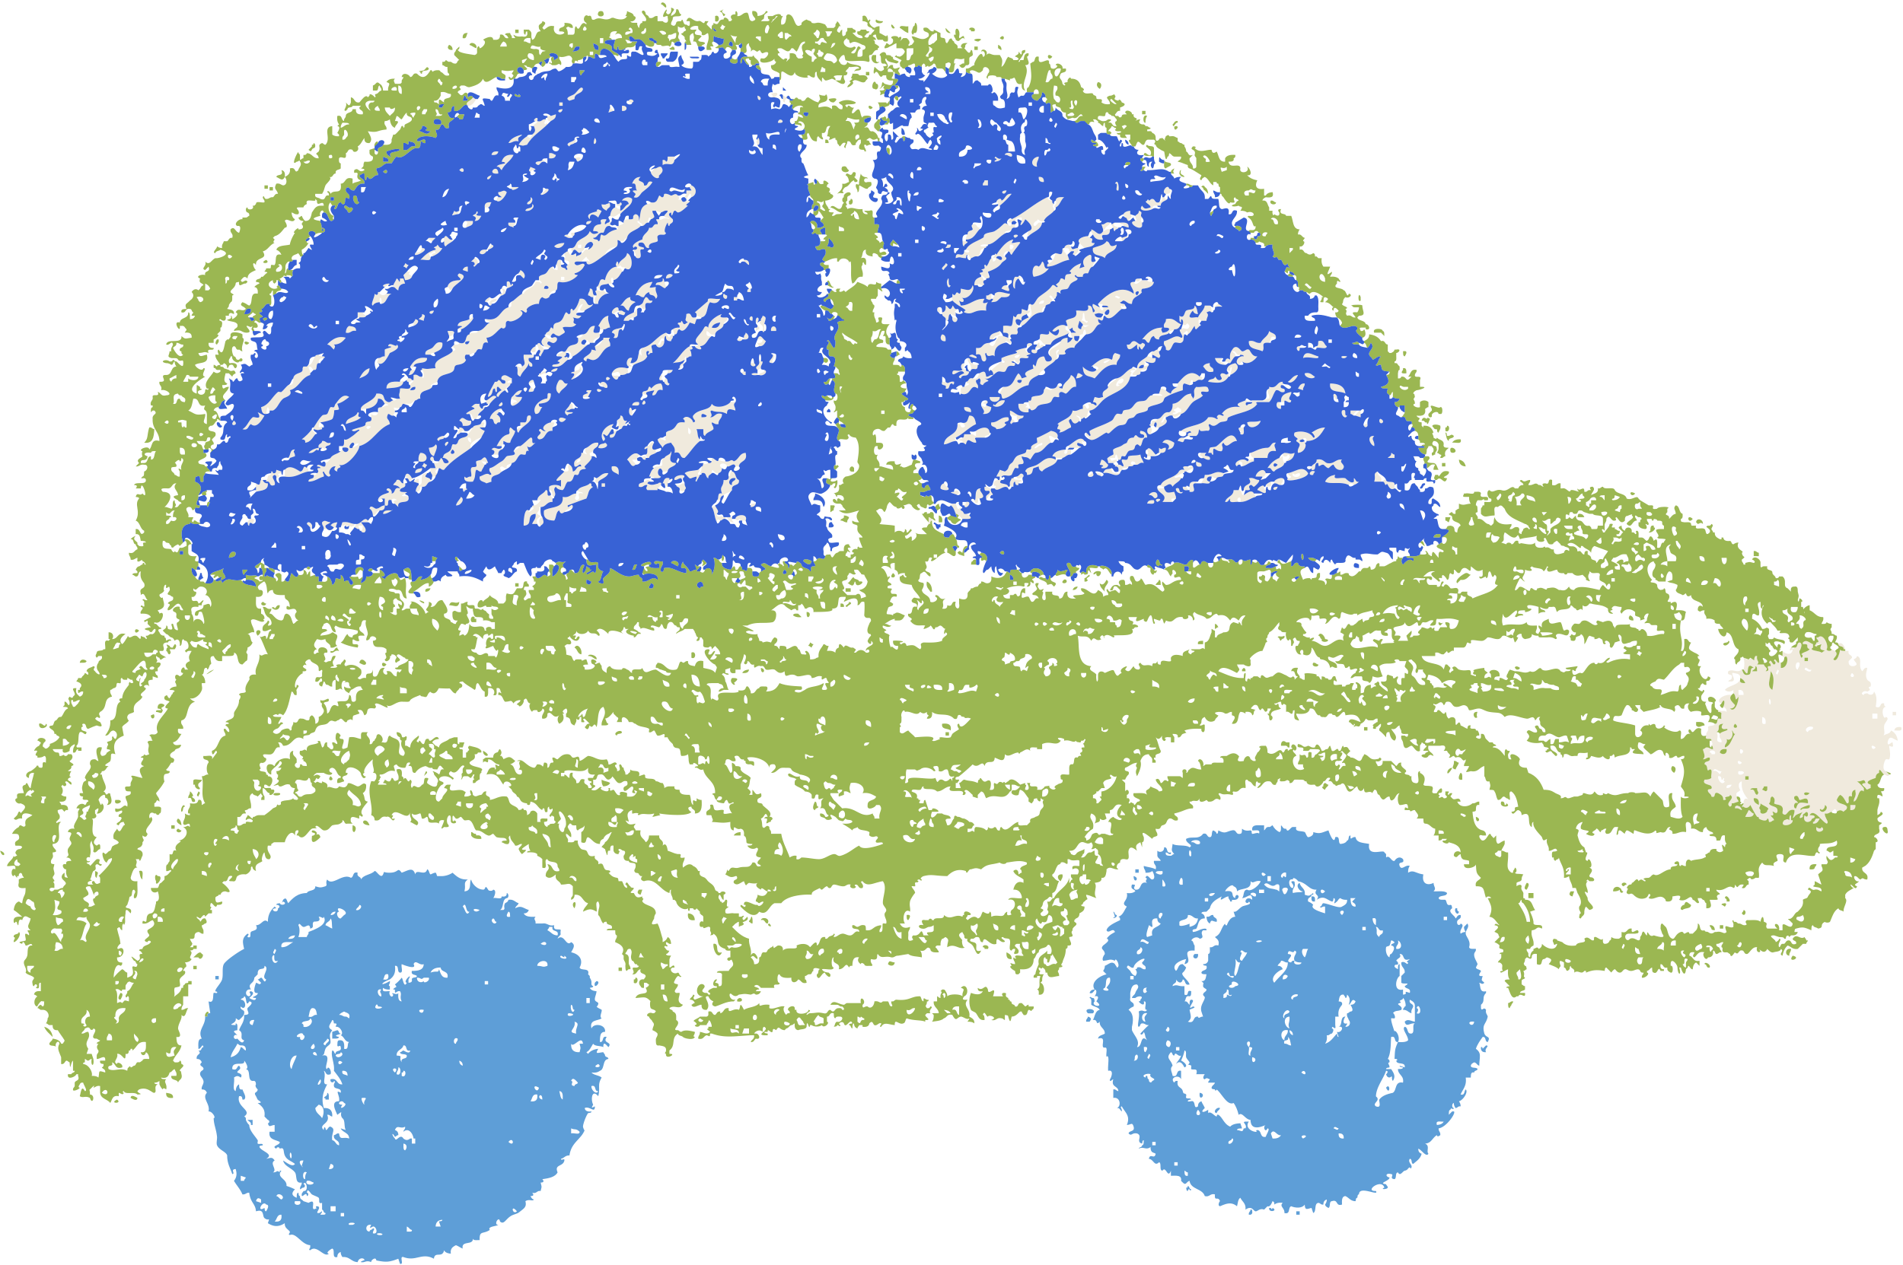

Fun Fact
How many lines of code does your car have?
How many lines of code does an airplane has?
Over 100 million lines of code (100,000,000)
~10 million lines of code

Slide 12

Homework: Copy Paste Run and Tweak
print("🐵 Welcome to the Quest for the Golden Banana!")
print("You are a brave monkey in the jungle, searching for the legendary fruit. 🍌")
print("You must choose wisely or face silly consequences.\n")
for round in range(10):
choice1 = input("You're at a jungle fork. Do you go left or right? ").lower()
if choice1 == "left":
print("\n🌊 You reach a river with a crocodile swimming nearby.")
choice2 = input("Do you swim or build a raft? ").lower()
if choice2 == "swim":
print("🐊 Oh no! You became croc-snack. Game over!")
elif choice2 == "build a raft":
print("🛶 Smart move! You float safely across and reach a cave.")
choice3 = input("Do you enter the cave or go around it? ").lower()
if choice3 == "enter":
print("💎 You found a glowing golden banana on a pedestal! You win!")
else:
print("🌪️ A storm catches you in the open. Game over!")
else:
print("🤷 You stand around until night falls. Game over.")
elif choice1 == "right":
print("\n🦜 A talking parrot offers you a riddle.")
riddle = input("What has hands but cannot clap? ").lower()
if "clock" in riddle:
print("🦜 'Correct!' says the parrot and flies away.")
print("You find a secret path to a banana temple.")
choice4 = input("Do you take the gold banana or the silver one? ").lower()
if "gold" in choice4:
print("🎉 The golden banana was real! You are now the Banana King!")
else:
print("😬 The silver one was cursed. You turn into a squirrel. Game over!")
else:
print("🦜 'Wrong!' The parrot drops coconut on your head. Game over!")
else:
print("\n❓ That’s not a valid direction. You trip on a root and roll back to the start.\n")
continue # loop back to the beginning
play_again = input("\nDo you want to play again? (yes/no): ").lower()
if play_again != "yes":
print("👋 Goodbye, adventurer!")
break

Slide 13
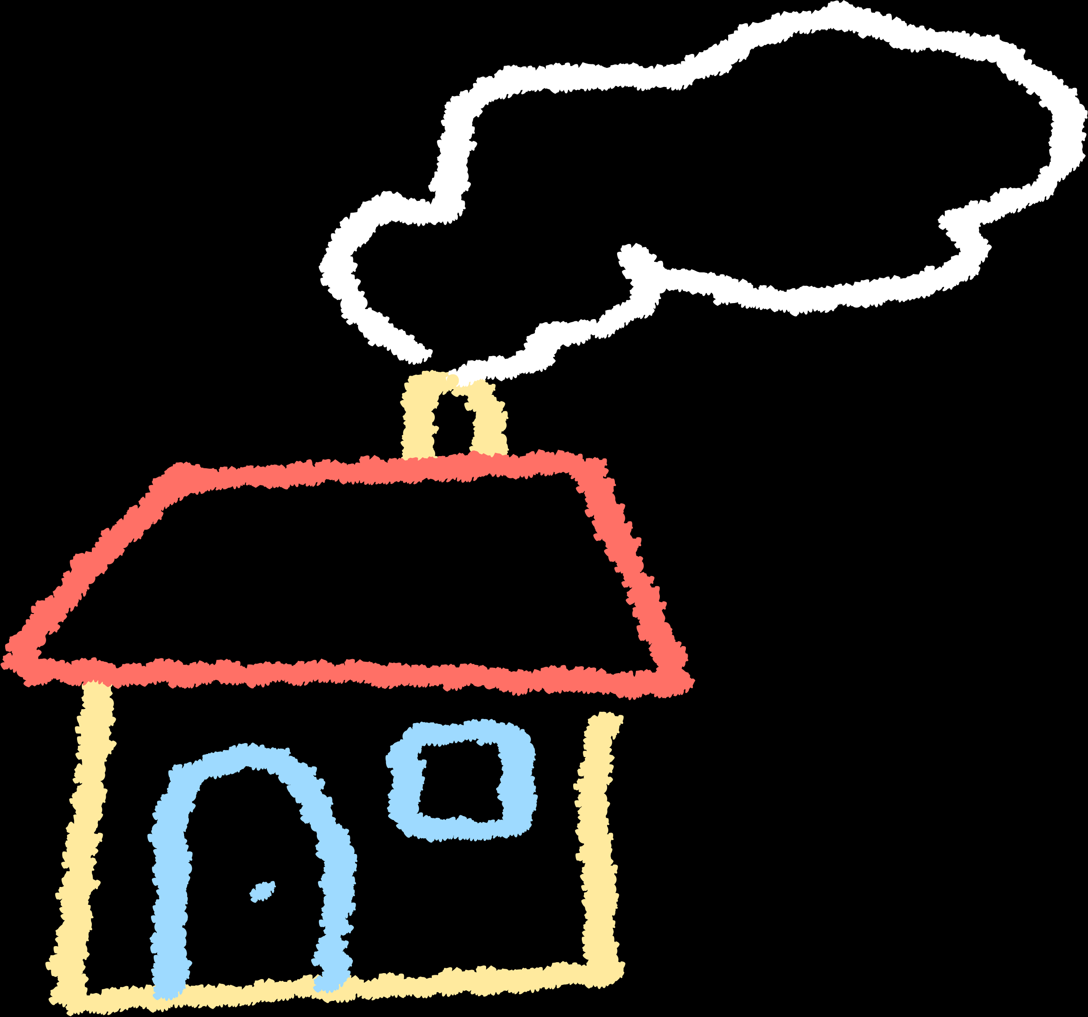
Homework
4. Guess the Secret Number
--------------------------
Ask the user to guess a number between 1 and 10. Tell them if they got it right or not. What should you replace “?????” with?
Example:
secret = 7
guess = int(input("Guess a number between 1 and 10: "))
if ?????:
print("🎉 Correct!")
else:
print("❌ Wrong! Try again.")
Bonus Challenge
---------------
Could you explain in words what this code is doing? What do you think is the function of “break”?
Example:
password = "python123"
for attempt in range(3):
guess = input("Enter the password: ")
if guess == password:
print("🔓 Access granted!")
break
else:
print("❌ Wrong password.")
else:
print("🔒 You are locked out.")
1. Simple Print Loop
--------------------
Write a program that prints your name 10 times using a for loop.
2. Count by Twos
----------------
This code prints all even numbers from 2 up to that number. Now write a code that prints all odd numbers up to the number.
Example:
num = int(input("Enter a number: "))
for i in range(2, num+1, 2):
print(i)
3. Triangle Builder
-------------------
Ask the user how many rows they want, and print a right-angle triangle using 'X'. Can you try to build a balanced triangle?
Example:
rows = int(input("How many rows? "))
for i in range(rows):
print("X" * (i+1))

Slide 14


Thank You

